Slide 1
Department of Mathematical Statistics
2020 г.

Slide 2
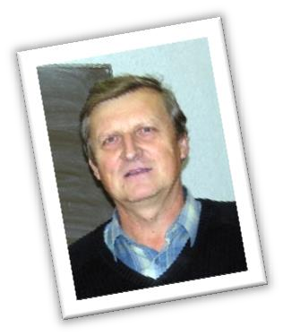






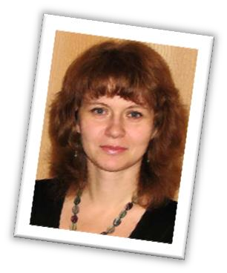



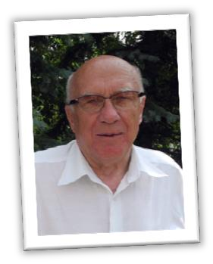
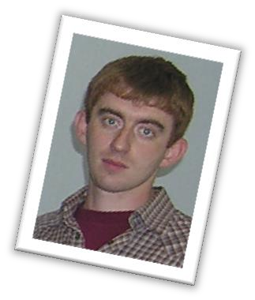
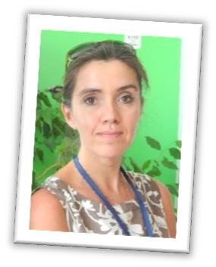
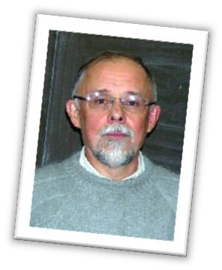

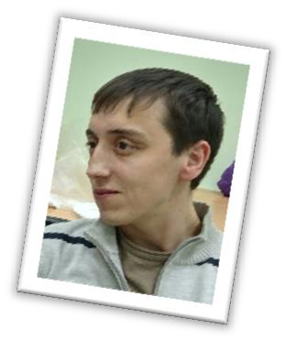
Department's staff
2 professors
21 teachers
11 associate professors
2 senior teachers
2 Doctors of Science
6 assistants
13 Сandidates of science
5 employees under 35 y.o.

Slide 3








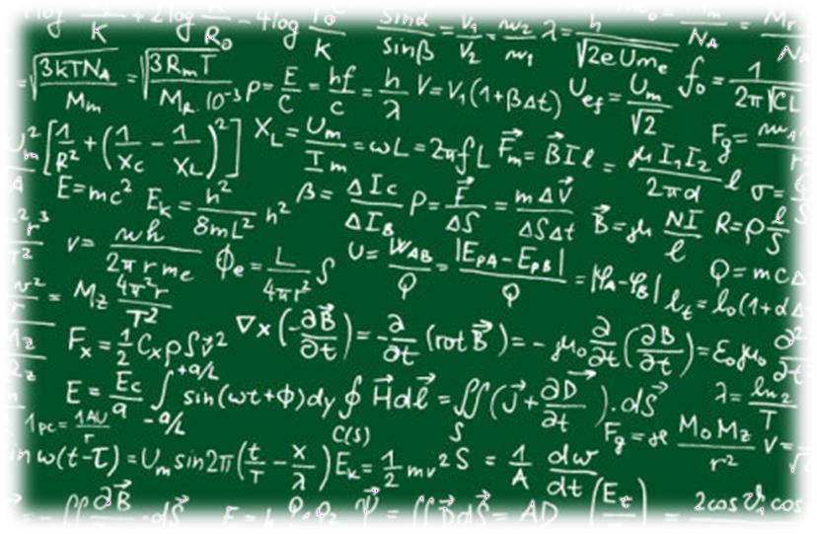
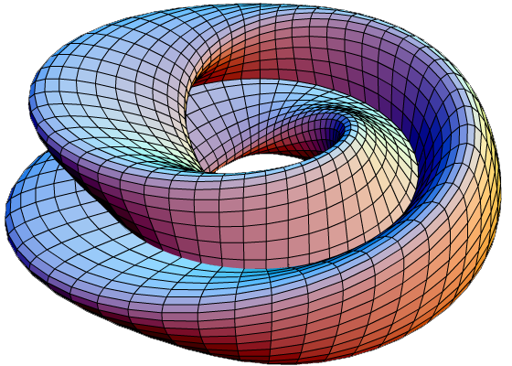
Adaptation and conducting classes for
other KFU institutes in
Educational activities:
disciplines
Ensuring the educational process of ICMIT’s baccalaureate in disciplines:
Mathematical analysis
Functional analysis
Comprehensive analysis
Theory of Probability and Mathematical Statistics
Theory of Probability
Mathematical Statistics
Statistical information processing methods

Slide 4





Educational activities:
educational programs
In 2015, a magistracy was opened under the program
Methods of Applied Mathematical Statistics
Unique to the Russia
Comparable to the University of Oxford program
Development of joint magistracy under the program
Financial Mathematics and Econometrics
with the Institute of Management, Economics and Finance.
Continuing Education Programs:
Statistical methods in medicine
Statistical methods in the petroleum industry

Slide 5
Educational activities:
baccalaureate disciplines
The department conducts for undergraduate directions
03.01.04 "Applied Mathematics"
03.01.02 "Applied Mathematics and Computer Science" specialized courses in:
Introduction to Actuarial Mathematics
Probabilistic Genetics Models
Probabilistic models and their statistical identification
Financial market volatility
Analysis of variance
The mathematical foundations of probability theory
Stochastic modeling method
Multivariate Statistical Analysis
R programming
Regression analysis
Random Process Statistics
Statistical Application Packages
Stochastic analysis
Martingale theory
Theory of random processes

Slide 6









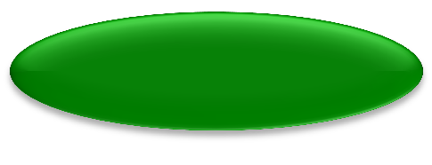





Educational activities:
international programs
Hispanic Master program in Applied Mathematical Statistics
2018
Mexico
BRICS
Venezuela
Education in Russian
Education in English
2019
Master's program "Methods of Applied Mathematical Statistics"

Slide 7

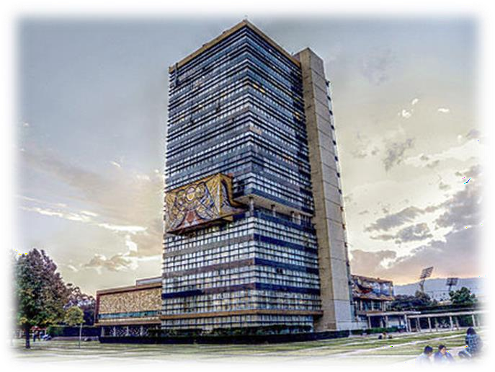







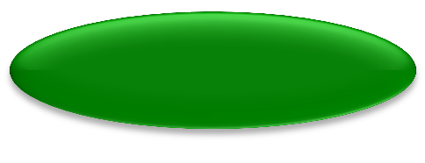





Czech Technical University
in Prague
Educational activities:
international programs
DMS of KFU
2018-2019
Postgraduate study in
functional analysis
Education in Russian
Education in English
2019-2020
Postgraduate study
(PhD program of KFU)
in TPMS
Universities of Mexico
DMS of KFU

Slide 8


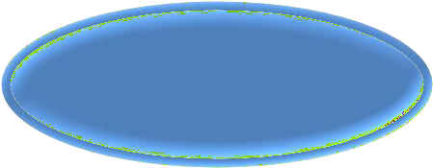


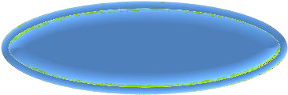

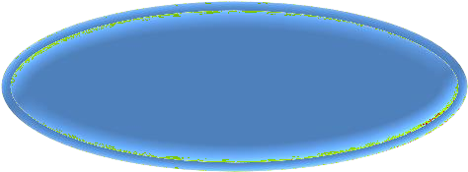

Practical applications of
disciplines
The disciplines developed and supported by the department are highly applicable in many areas.
Actuarial Math
Insurance companies
Statistical Methods of Banking: Scoring
Banks
Information methods in banking
Finance companies
Stochastic Methods of Theoretical Management

Slide 9

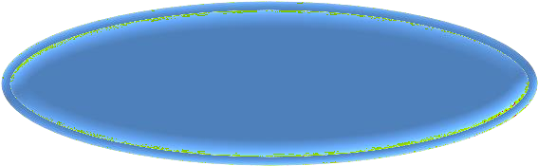
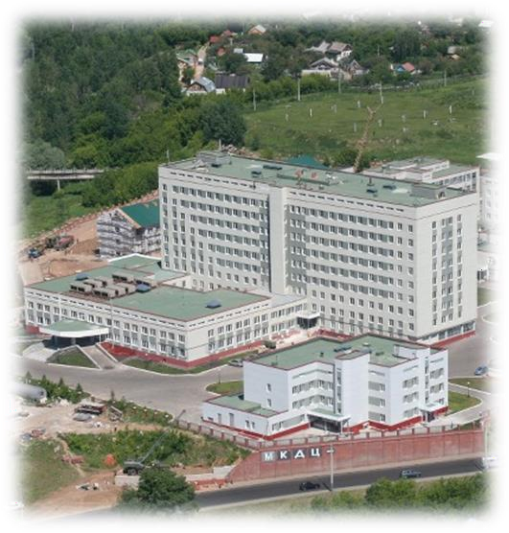


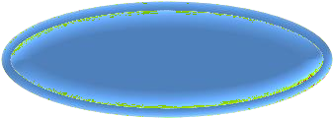
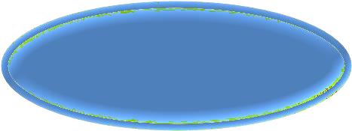




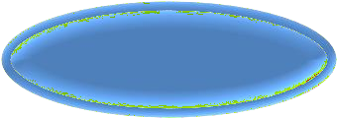



Practical applications of
disciplines
Optimal Statistical Solutions
Medical University
Statistical Analysis of Sampled Data
ICDC
Statistical Methods of Mathematical Genetics
IFMB of KFU
Reliability theory
KMPO
Probabilistic models and their statistical identification
SOV-TECH
Regression analysis

Slide 10
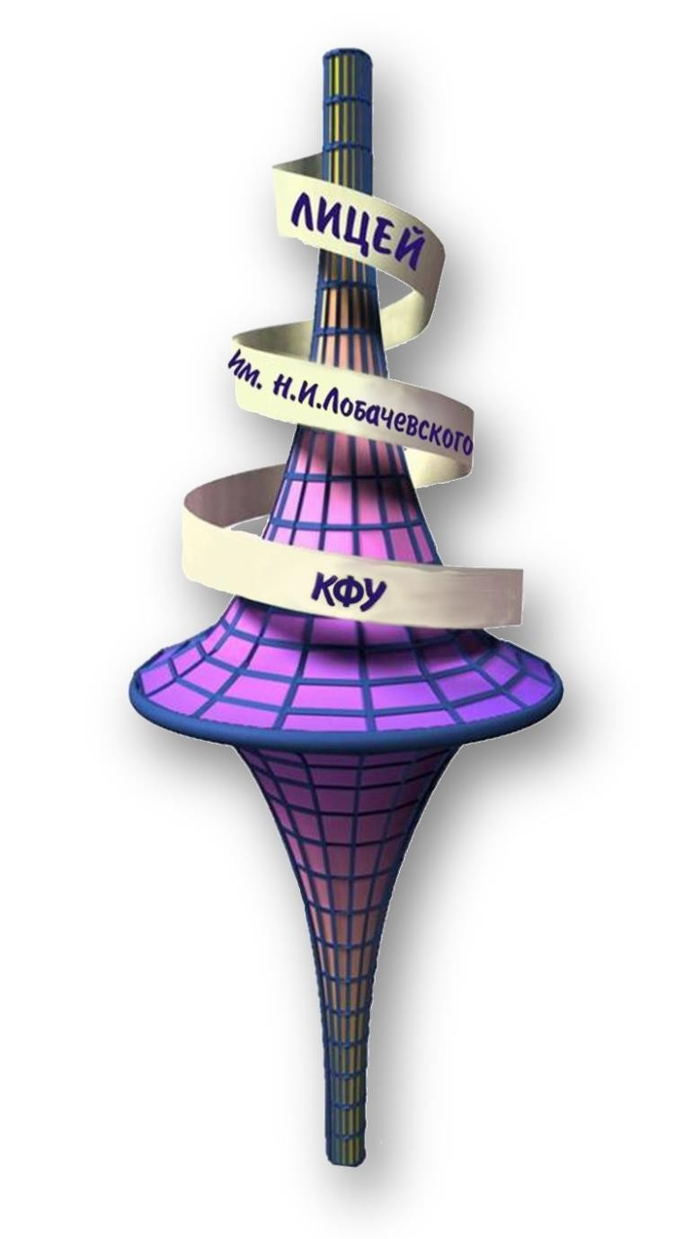




Work with applicants and
schoolchildren
Lyceum of KFU
Center for testing and preparation for the exam
Refereeing the stages of the All-Russian Olympiad of students in mathematics
Work with foreign applicants

Slide 11








Department partners
Czech Technical University in Prague (Czech Republic)
Shenzhen University (PRC)
Tianjin University of Economy and Finance (PRC)
University of Regina (Canada)
University of Oulu (Finland)
Steklov Institute of Mathematics
Kazan Institute of Biochemistry and Biophysics KSC RAS

